Slide 1

SPOTIFY DATA ANALYSIS
Phuong Aissa
Liseth Rubio

Slide 2
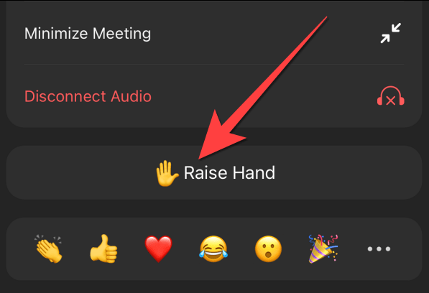
Raise your hand if you use Spotify!
Over 615 million users worldwide
Offers 70 million tracks
Largest music streaming platform
US is the country with more users (over 100 million)
Taylor Swift and The Weeknd are the singers with most monthly listeners.

Slide 3
Research Questions
The most streamed artists in Spotify-Top 5
The least streamed artists in Spotify-Bottom 5
Percentages of the most and least popular ranges of BPMs
Danceability Rate across different music platforms: Spotify, Apple, Shazam, and Deezer
Descriptive statistics and linear regression on danceability rate across different music platforms
Music popularity (number of streams) over time from 1930 to 2023

Slide 4
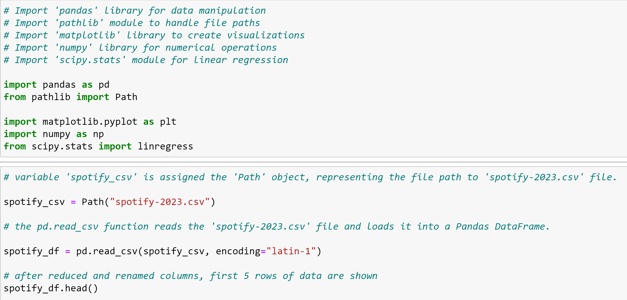
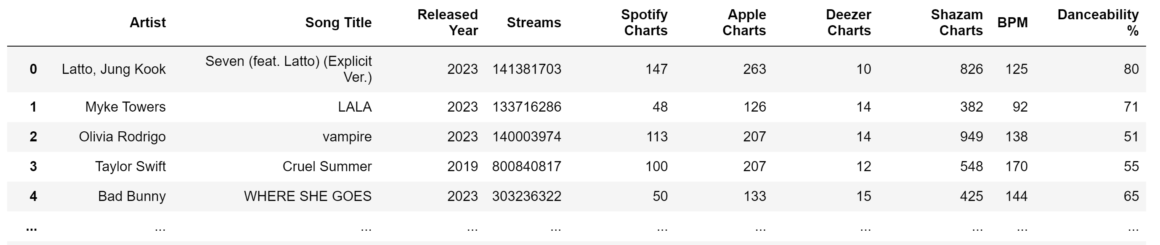
DataFrame Creation

Slide 5
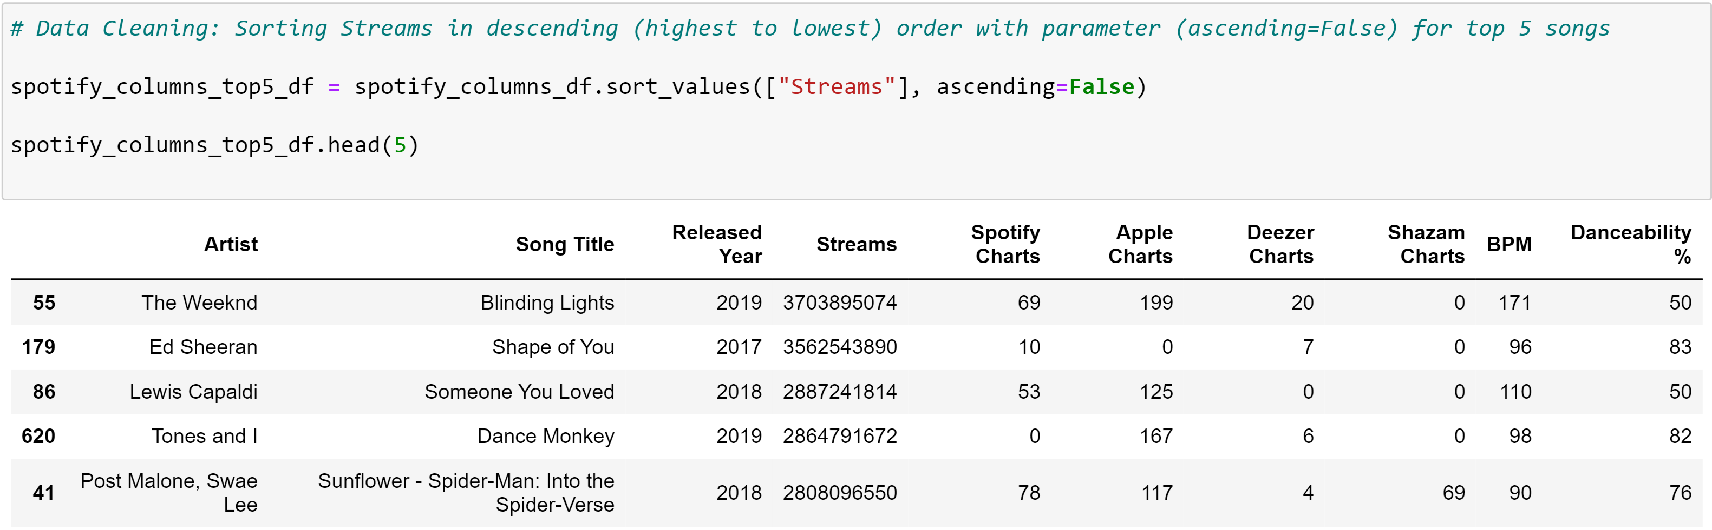
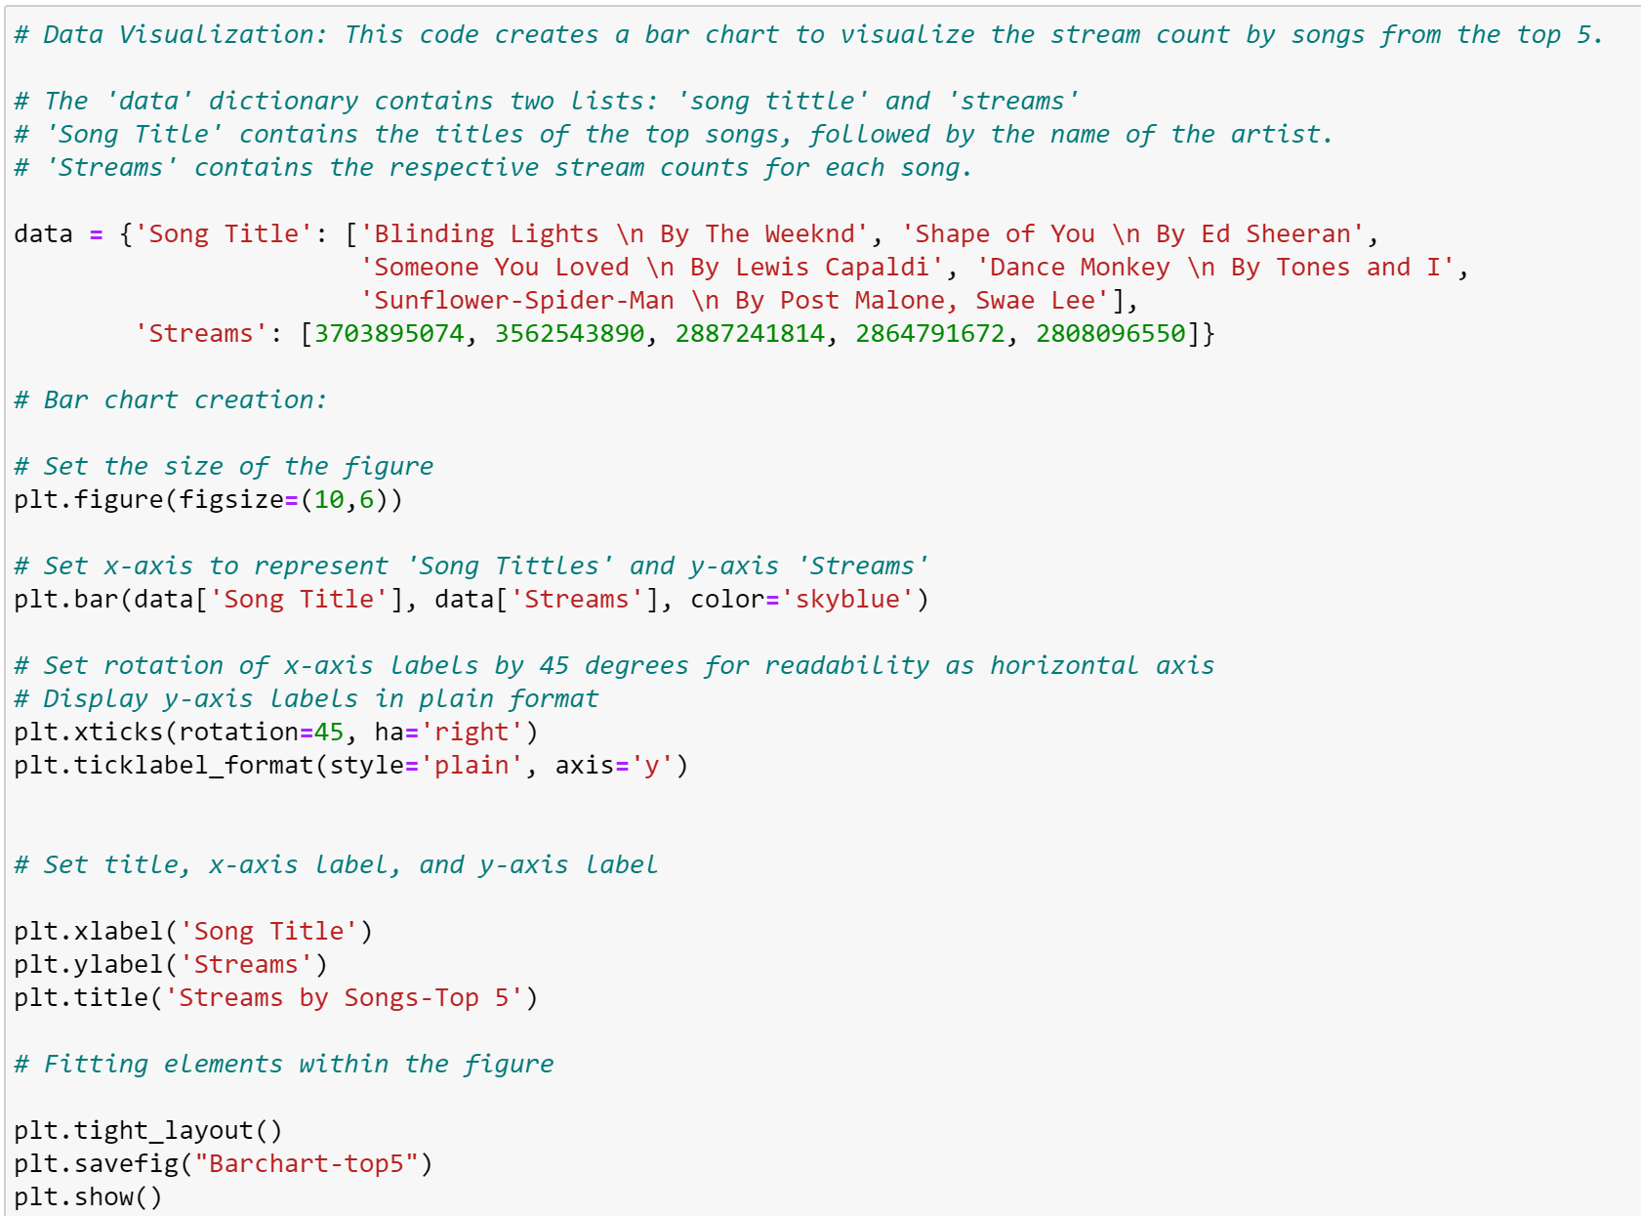
Most Streamed Songs on Spotify (Top 5)

Slide 6

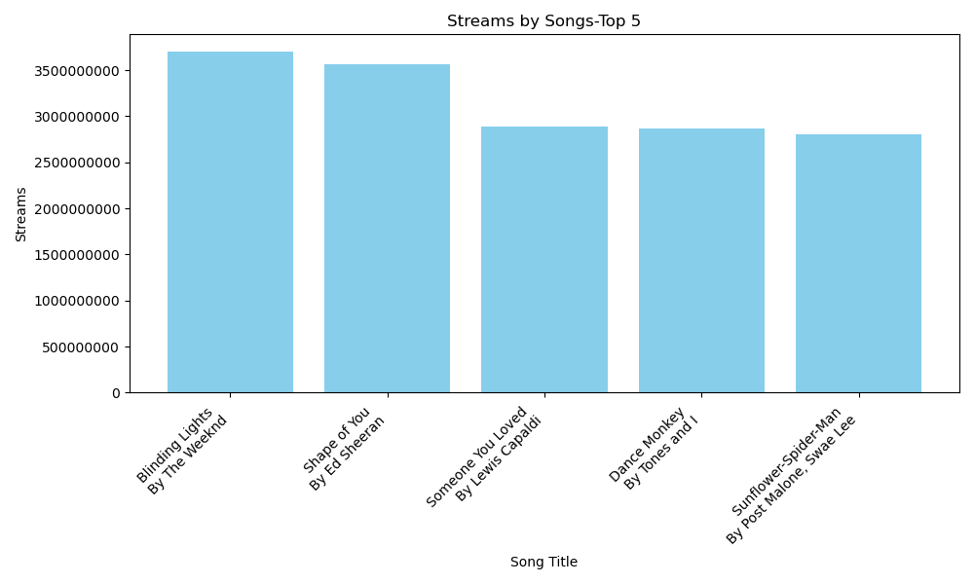
Most Streamed Songs on Spotify (Top 5)

Slide 7
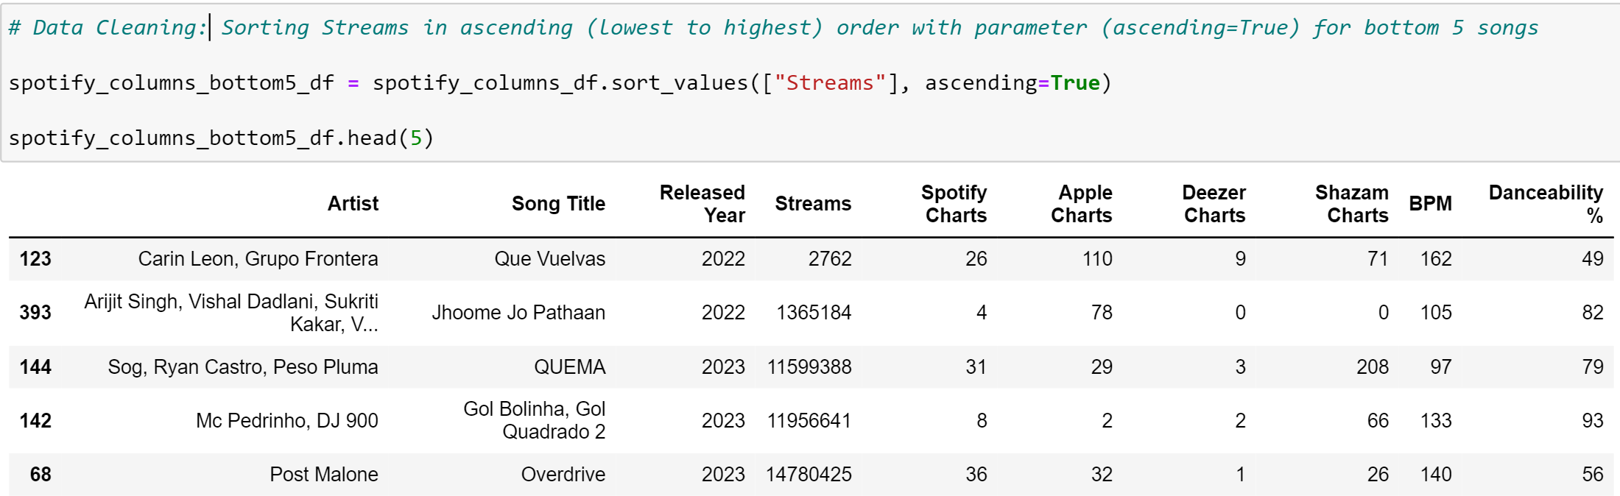
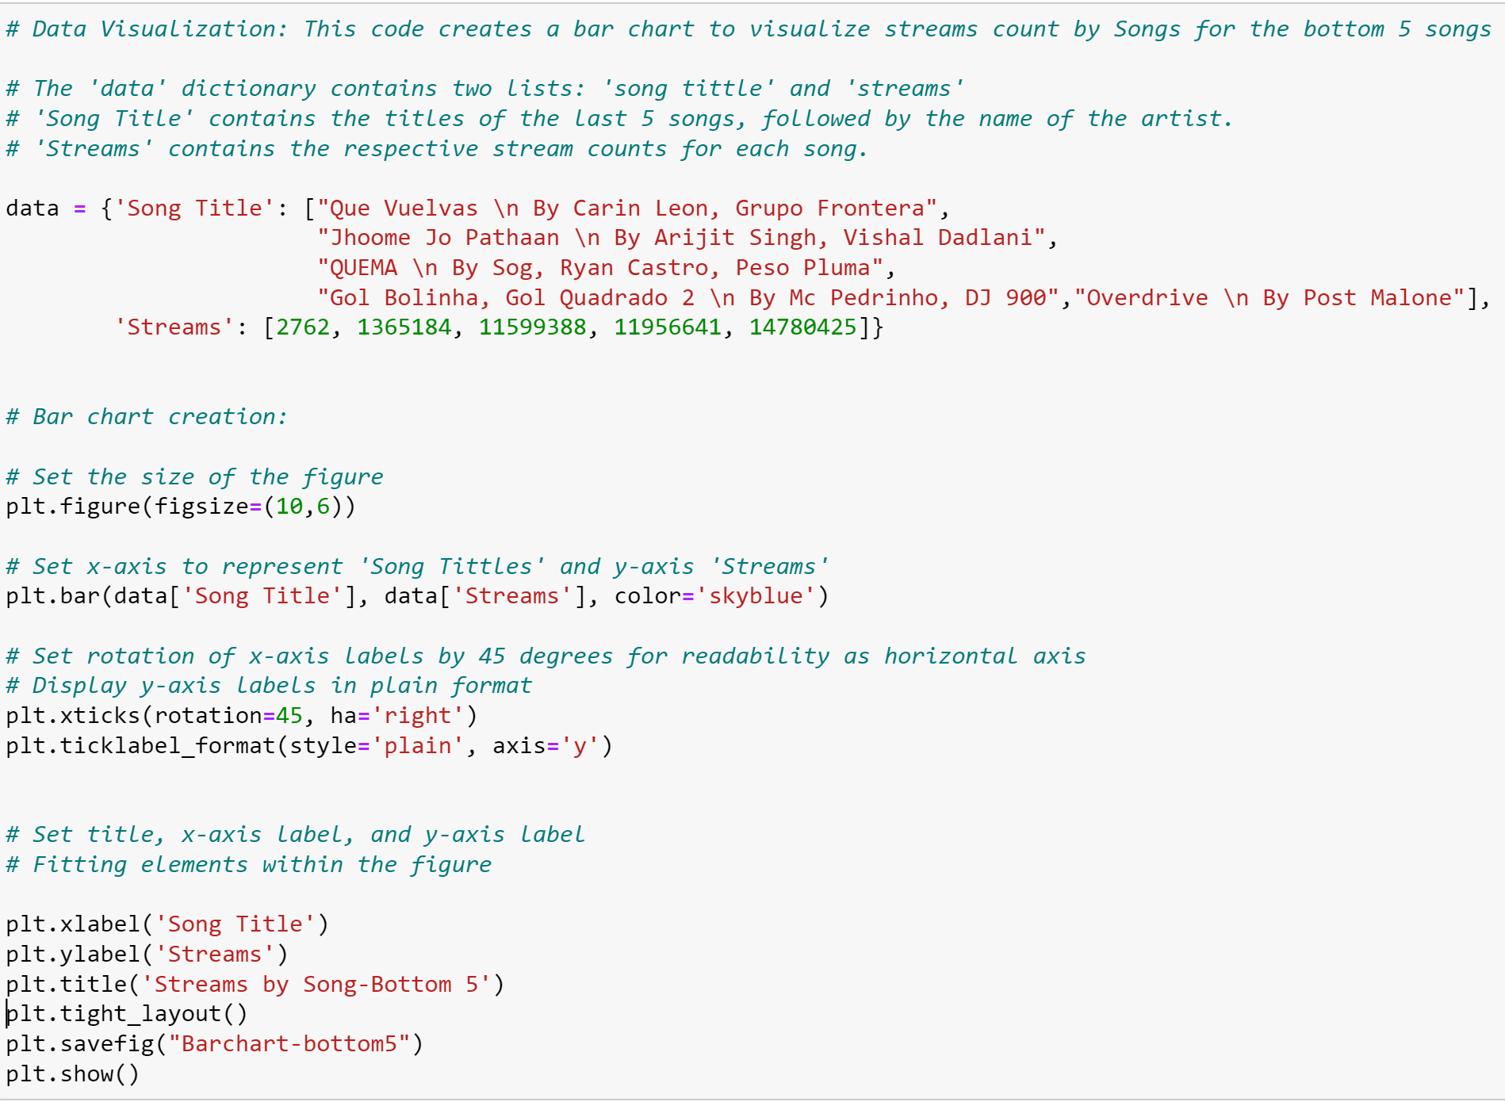
Least Streamed Songs on Spotify (Bottom 5)

Slide 8
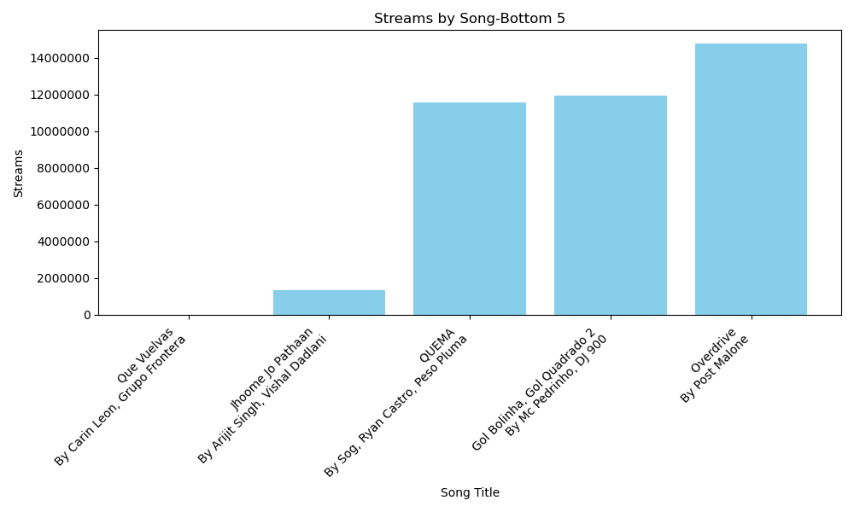
Least Streamed Songs on Spotify (Bottom 5)

Slide 9
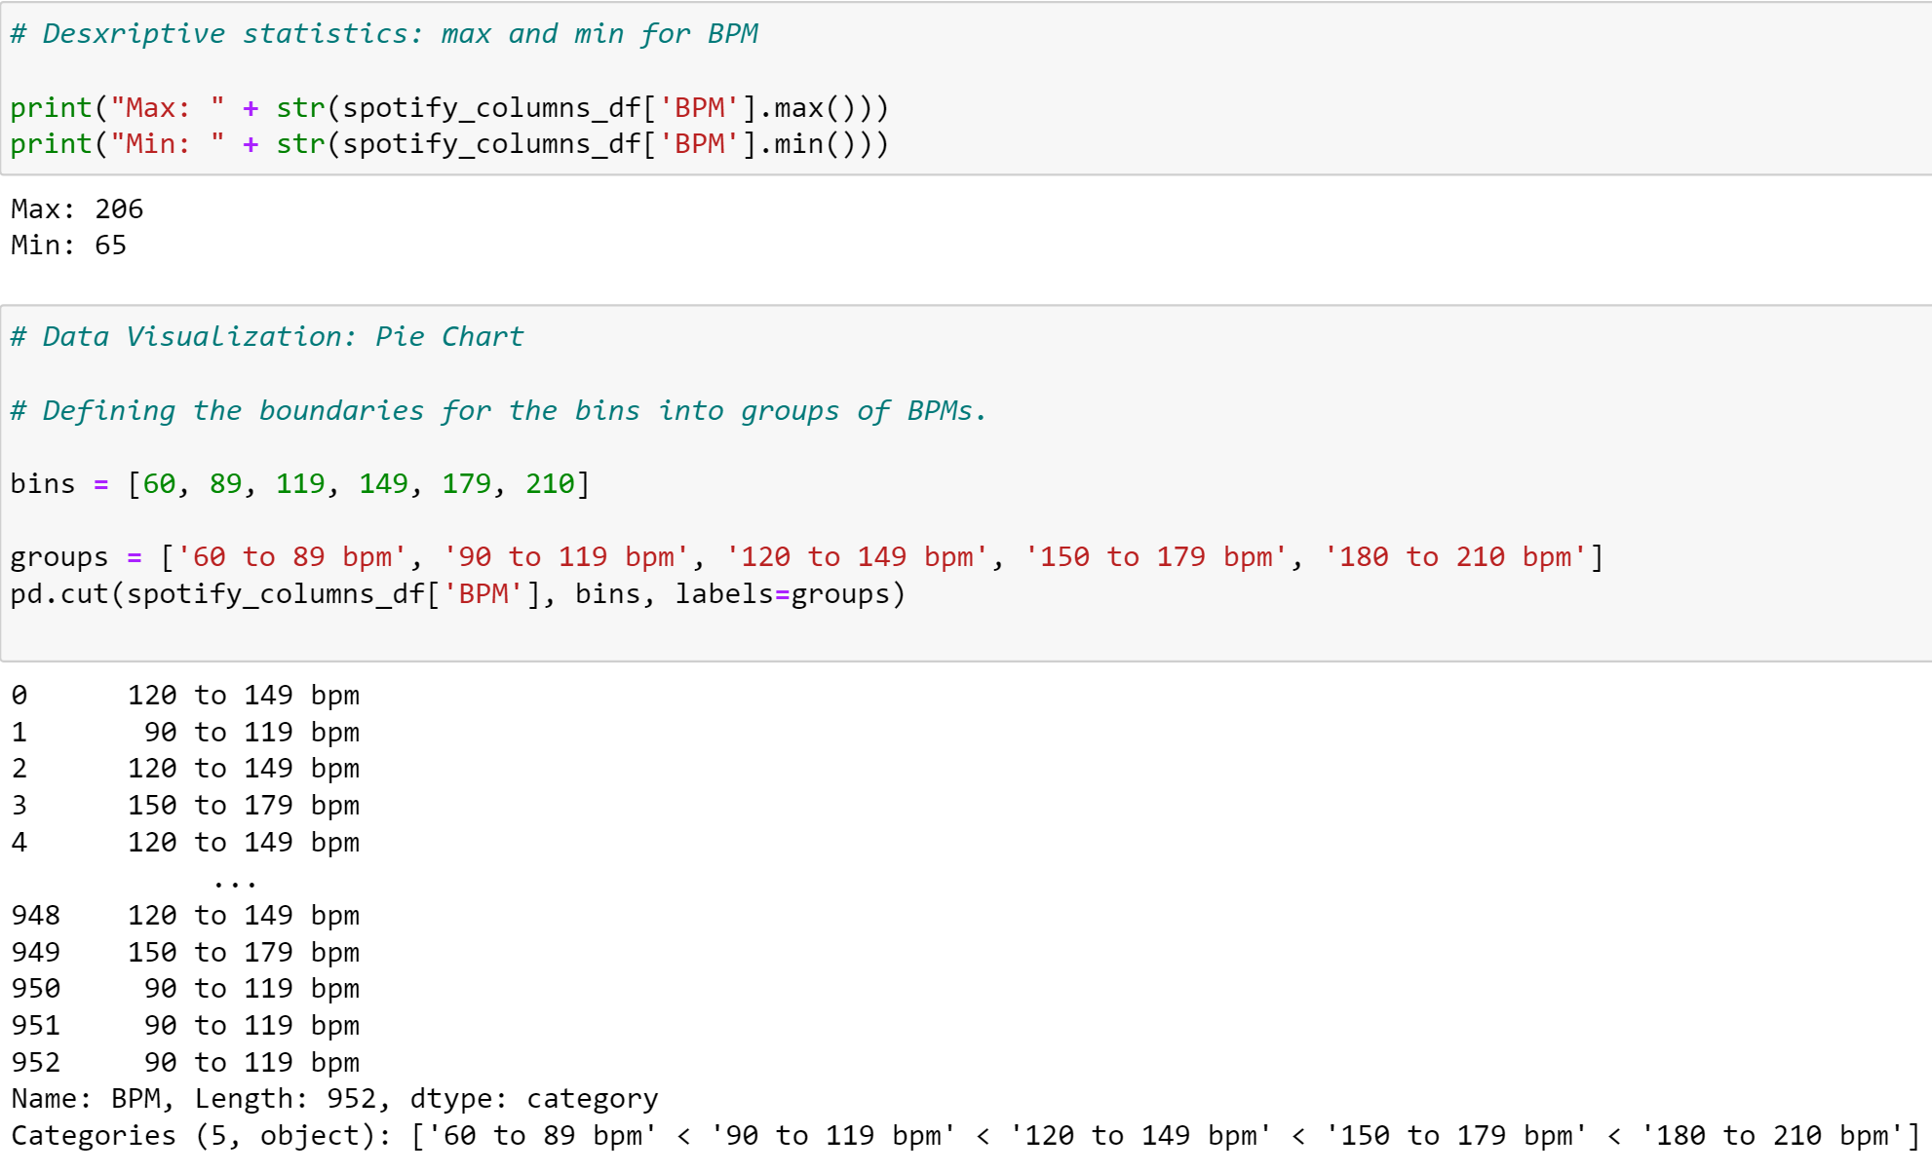
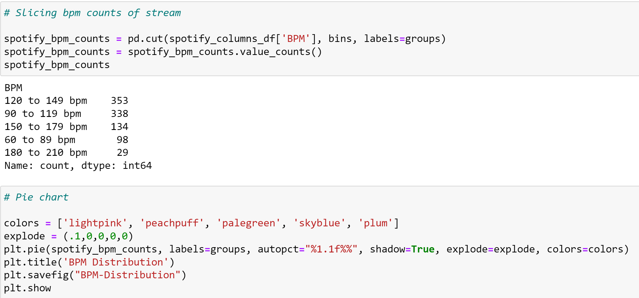
BPM Distribution by Percentages

Slide 10
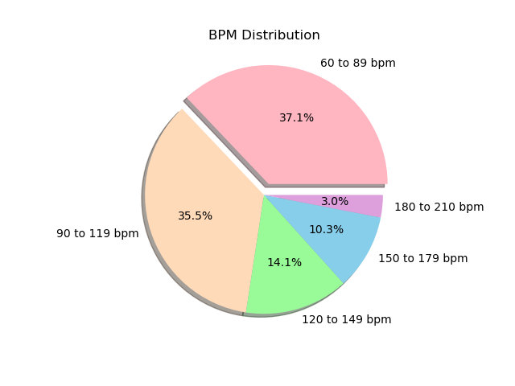
BPM Distribution by Percentages

Slide 11
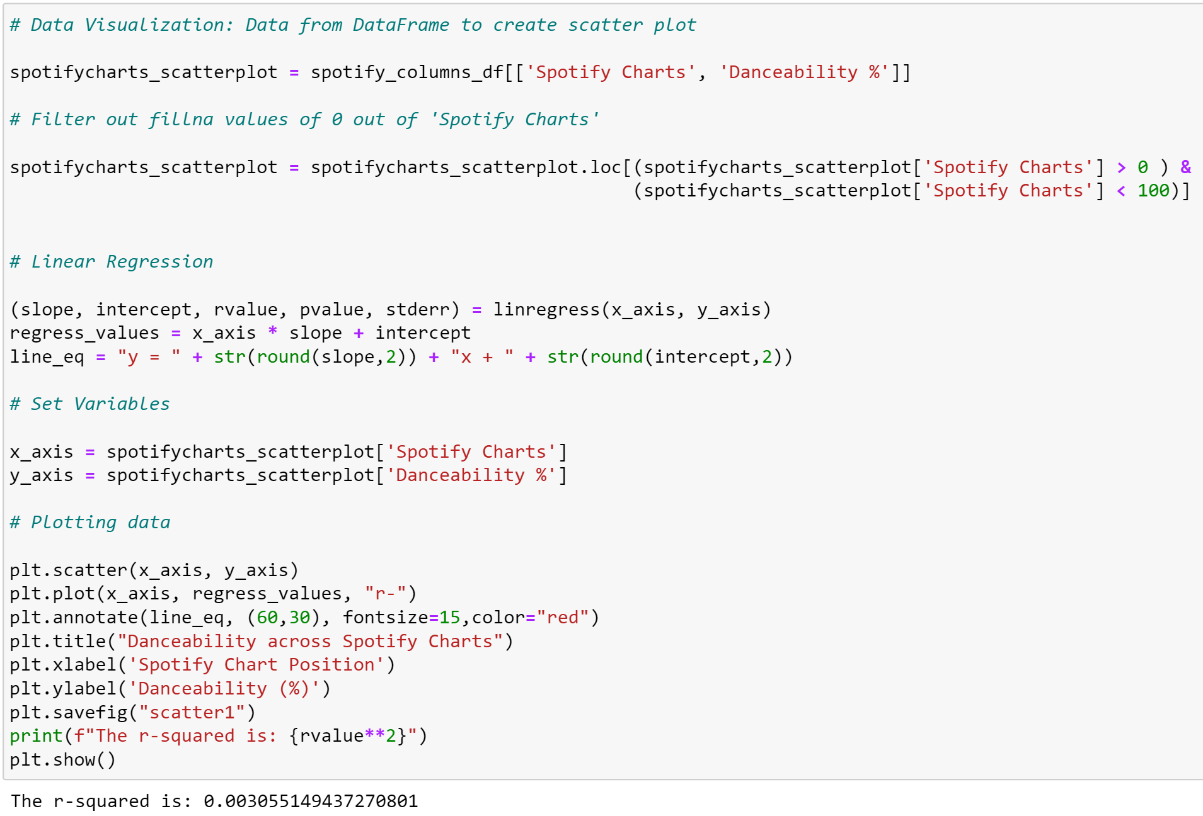
Danceability Rate across Platform Charts

Slide 12
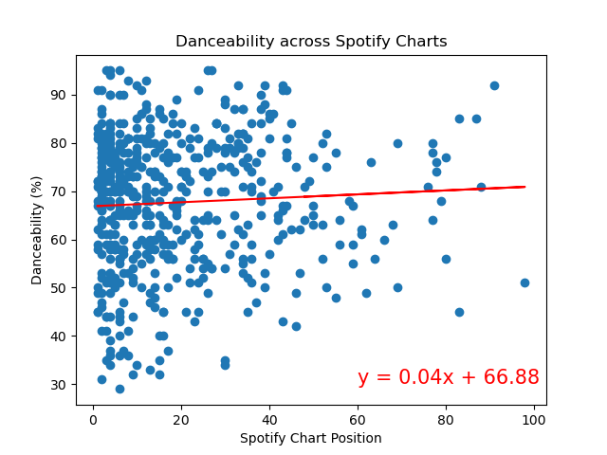
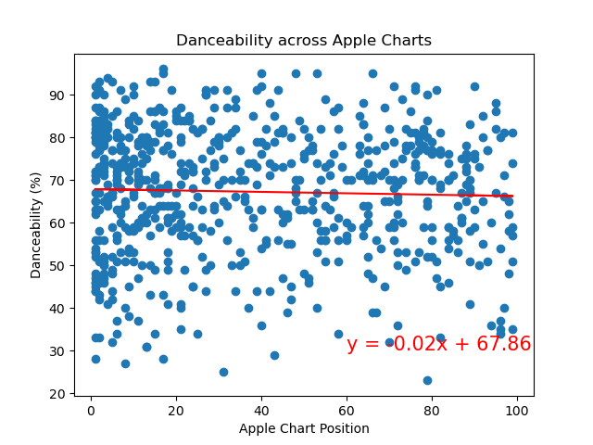
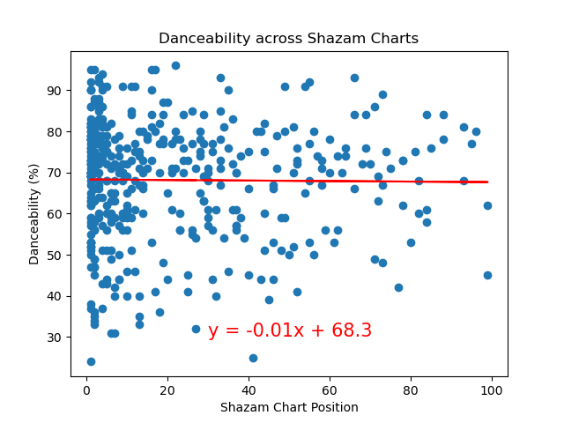
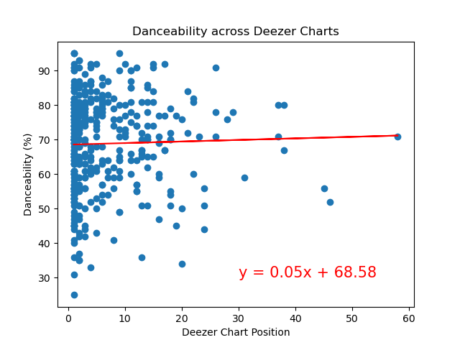
Danceability Rate across Platform Charts

Slide 13
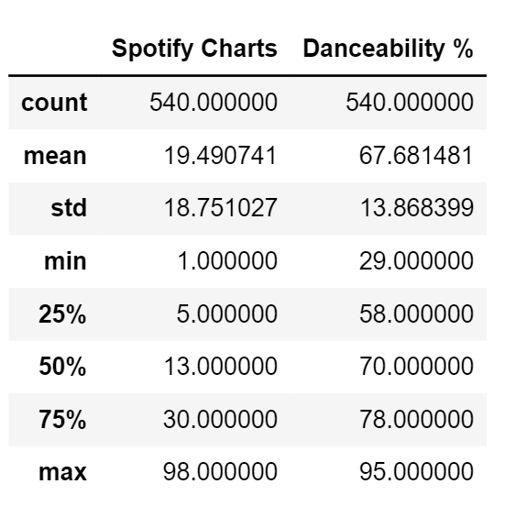
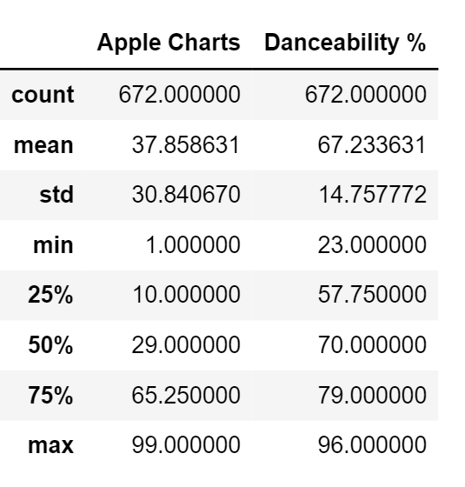
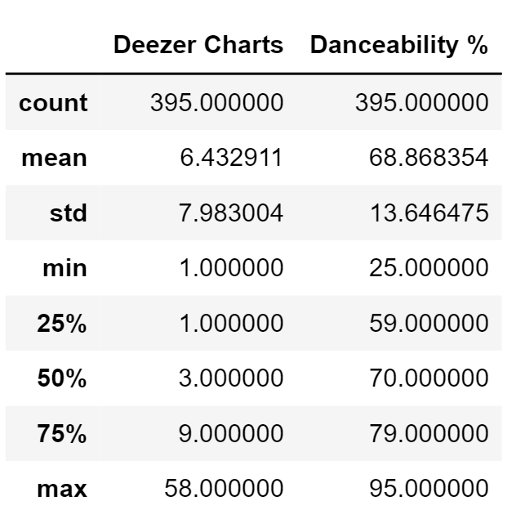
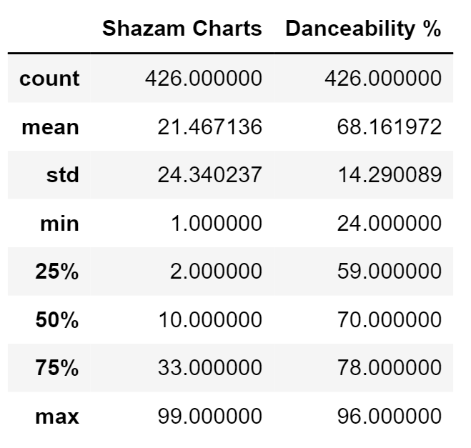
Descriptive Statistics on Danceability Rate across Platform Charts

Slide 14
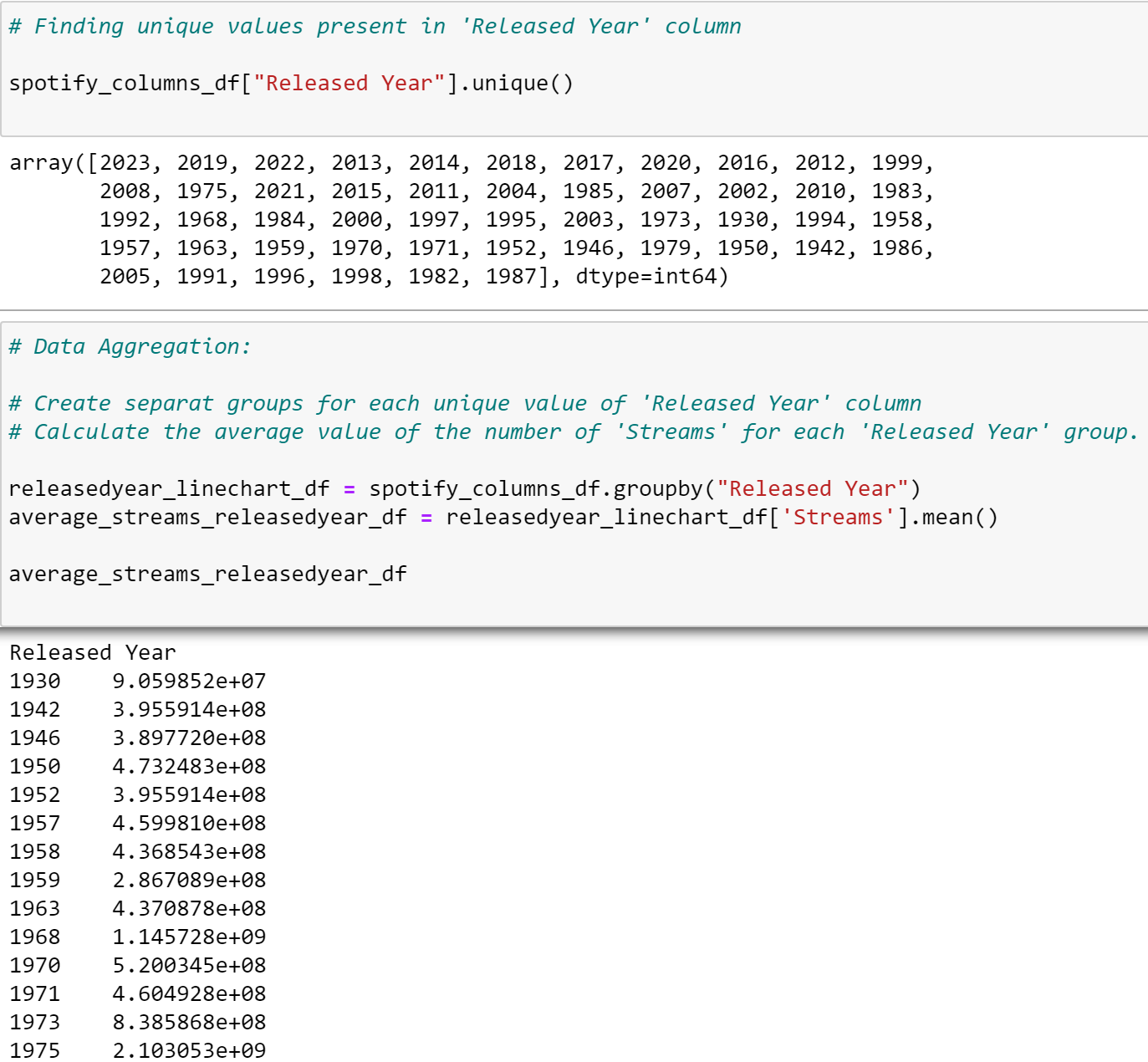
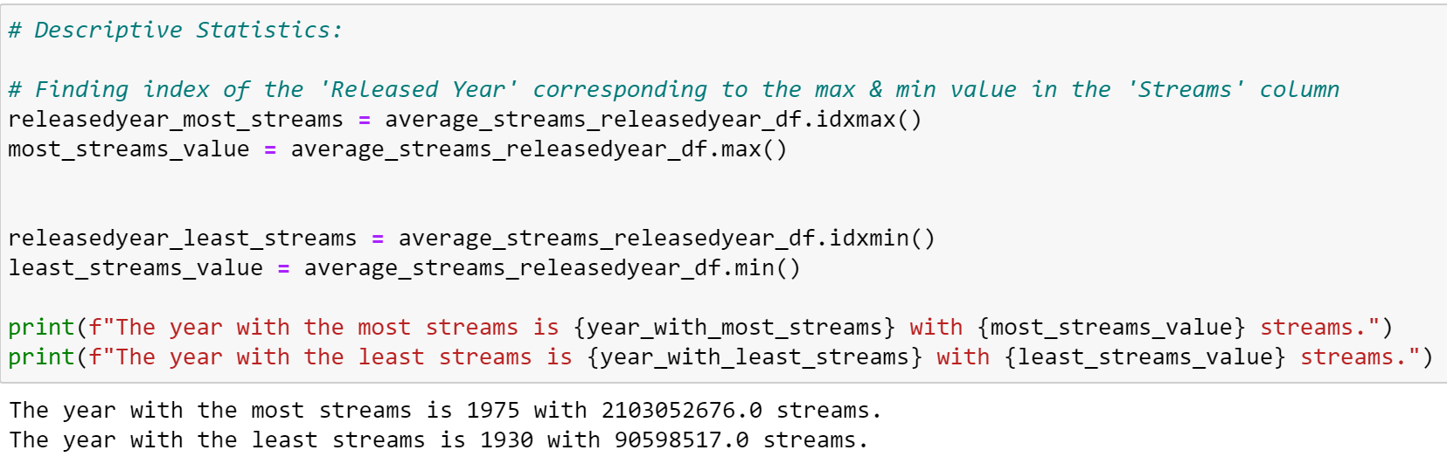
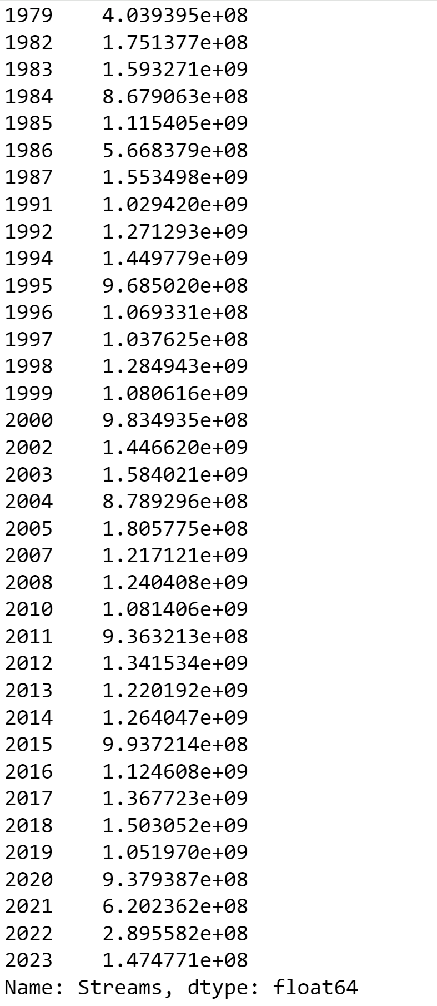
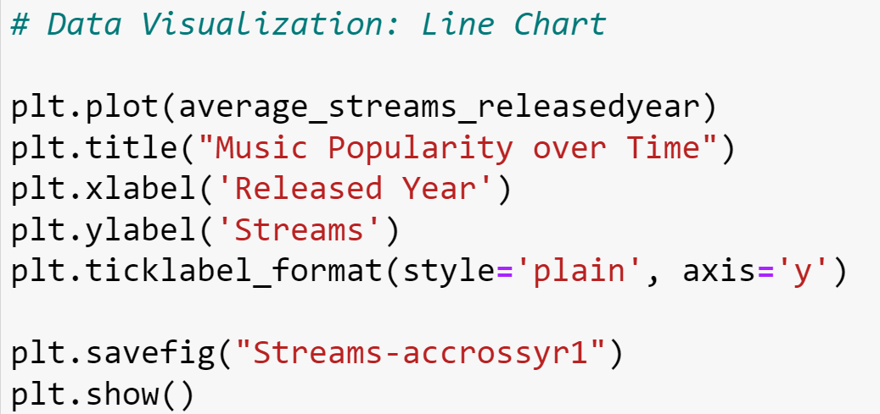
Music Popularity (Number of Streams) over Time

Slide 15
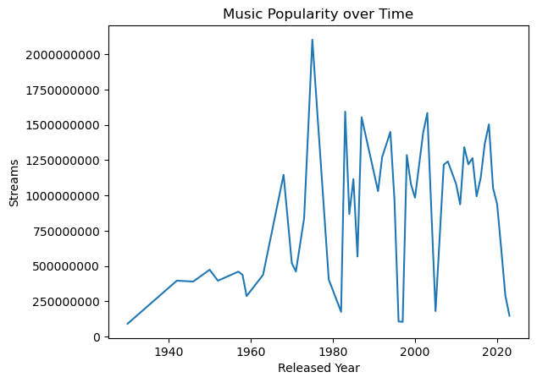
Music Popularity (Number of Streams) over Time
The year with the most streams is 1975 with over 2 billion streams.
The year with the least streams is 1930 with over 90 million streams.

Slide 16
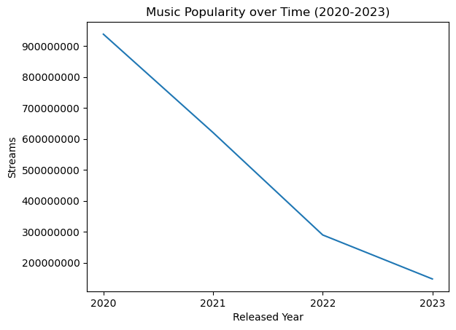
Music Popularity (Number of Streams) over Time (2020-2023)
Declining trend from 2020 to 2023, indicating a decrease in streams count as time continues.

Slide 17
Conclusions
The most streamed artist in Spotify from 1930 to 2023: The Weeknd.
The least streamed artist in Spotify from 1930 to 2023: Carin Leon.
Most of Spotify’s top songs fall within the 60 to 120 beat per minute (BPM) range.
There is no linear correlation between the song’s popularity and its danceability.
On average, songs in the top 100 charts have a danceability rating of around 70%.
The year with the most streams on average is 1975 (over 2 billion streams).
The year with the least streams on average is 1930 (over 90 million streams).

